Slide 1



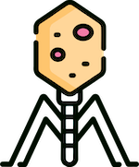

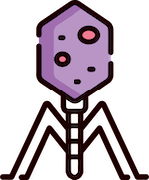



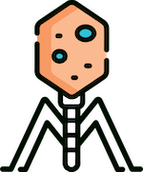
MSC COMPUTATIONAL SCIENCES THESIS DEFENSE
VICTOR PIASKOWSKI
UNIVERSITY OF AMSTERDAM
VRIJE UNIVERSITEIT
DR. MATTI GRALKA

Slide 2

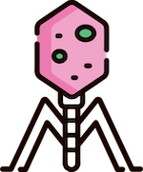



01
02
INTRODUCTION
BACKGROUND
04
05
RESULTS
ANALYSIS AND CONCLUSIONS
03
METHODOLOGY
PROJECT OUTLINE
PHAGE BIOLOGY
DASHBOARD AND ODE MODEL
COLORFUL PLOTS AND LINES!
BIGGEST TAKEAWAYS

Slide 3





01
INTRODUCTION
PROJECT OUTLINE

Slide 4






Mathematically Modeling the Interactions Between Phages, Bacteria, and the Environment
RQ1
RQ2
How do phages impact community dynamics in complex microbial communities?
How can you effectively model and interact with any pxbxr system?

Slide 5



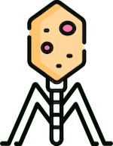

PROBLEM
Model multiple phages, bacteria and resources in complex, continuously evolving systems
10s to 100s of phages, bacteria and resources
Unique interactions and characteristics
External (environment) influence

Slide 6




CHALLENGE
Current ODE models focus on 1x1x1 or 2x1x1 systems
Niche or specific situations
Limited flexibility in modelling systems and environment
Varying or unknown conditions, model, and input

Slide 7

ANSWER
Flexible simulation framework
Network representation
Model individual states
Standardize input and output
Models varying model complexities
Easy to setup
Interactive GUI tool and dashboard frontend

Slide 8



02
BACKGROUND
PHAGE BIOLOGY

Slide 9

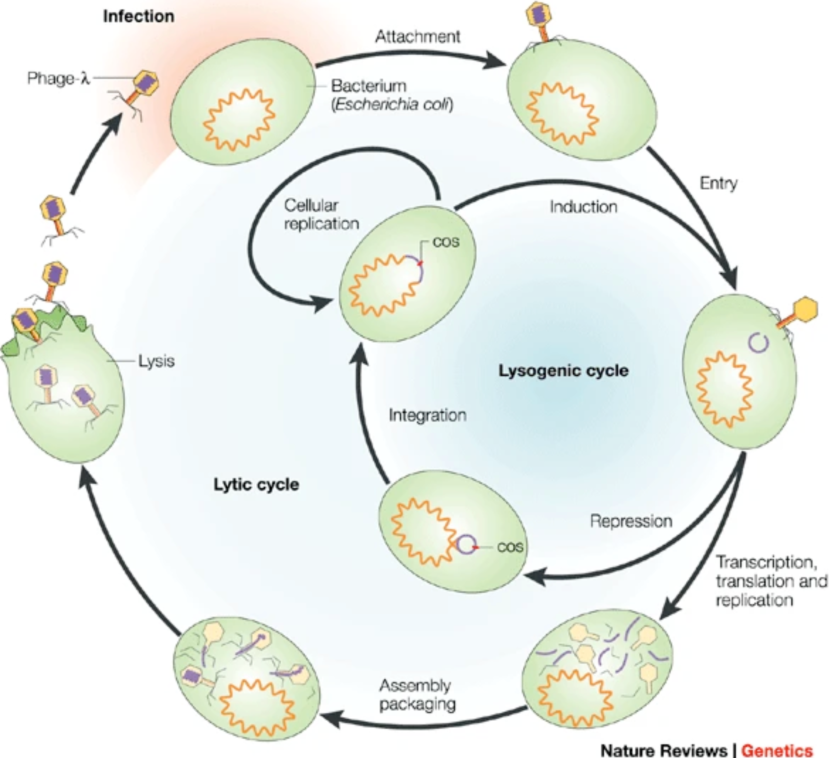
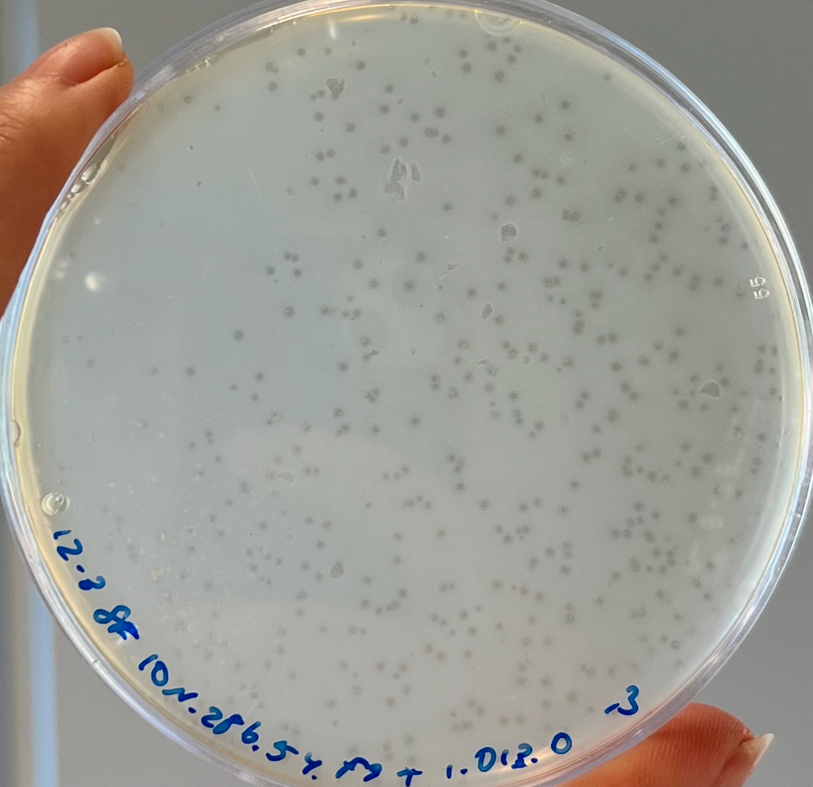
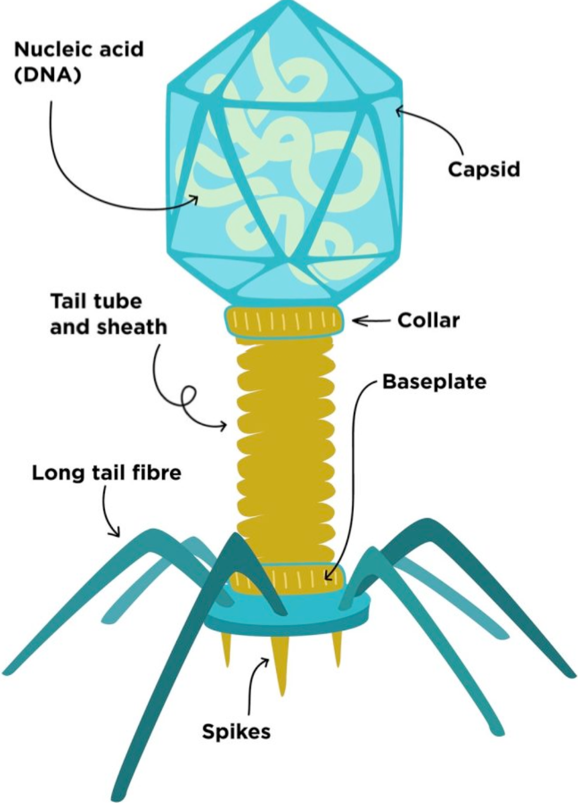
Phages in The Environment
30% of all daily marine bacteria death due to phages
Important role in nutrient turnover and bacteria fitness

Slide 10
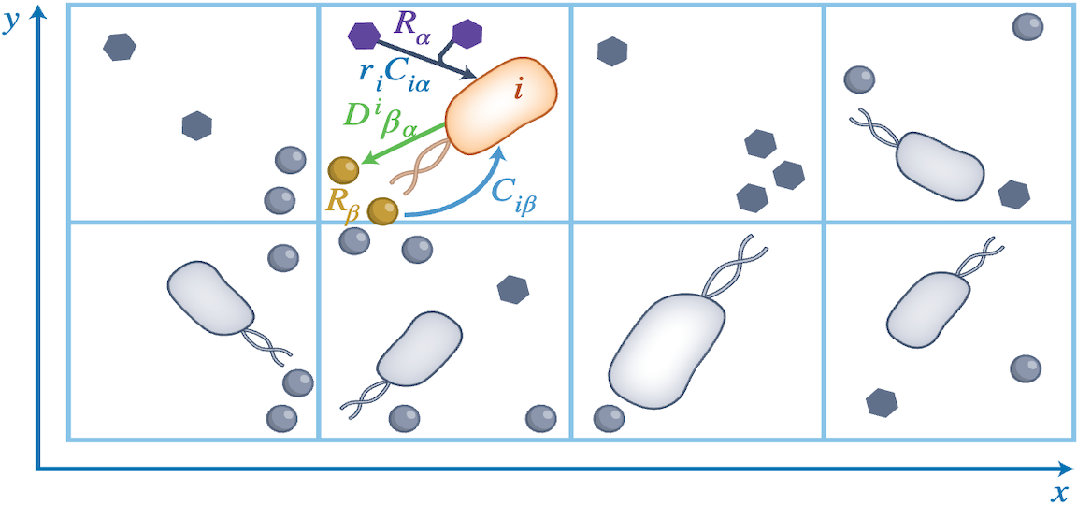
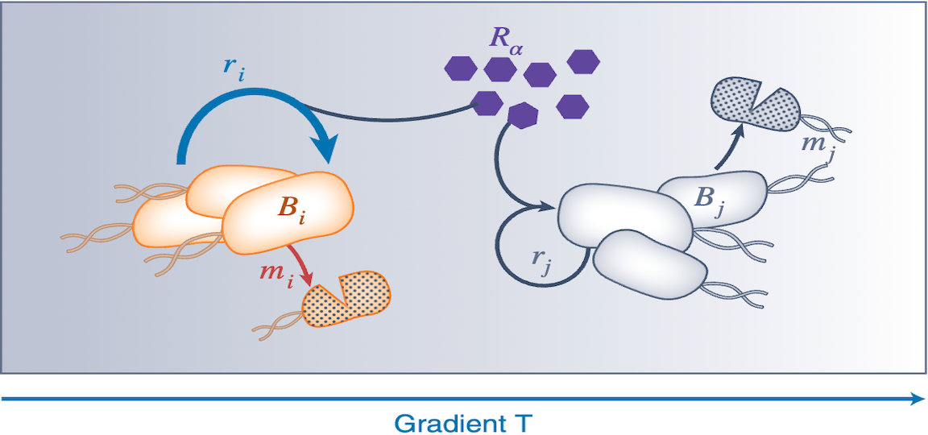
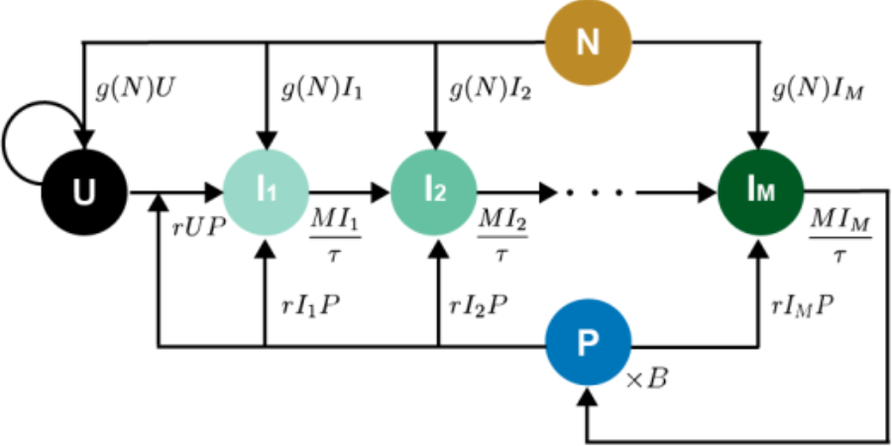
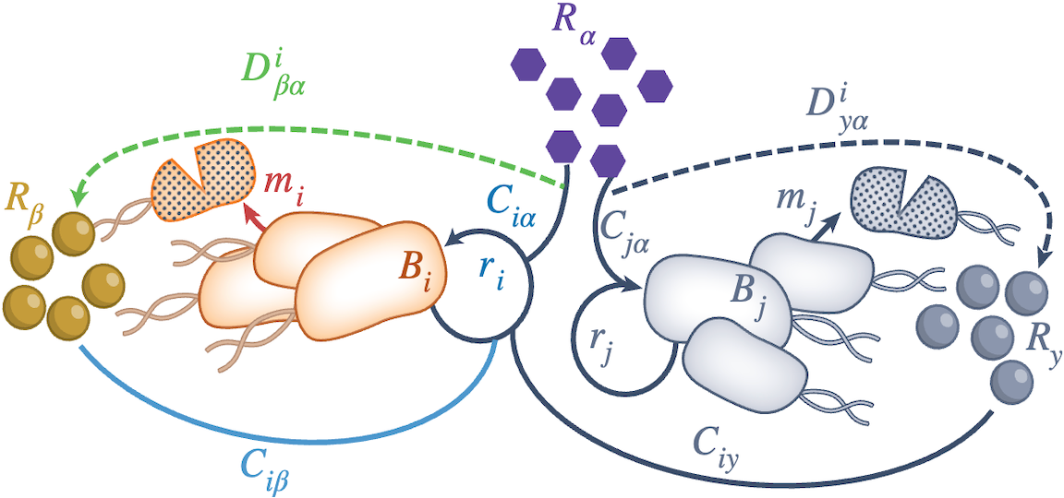
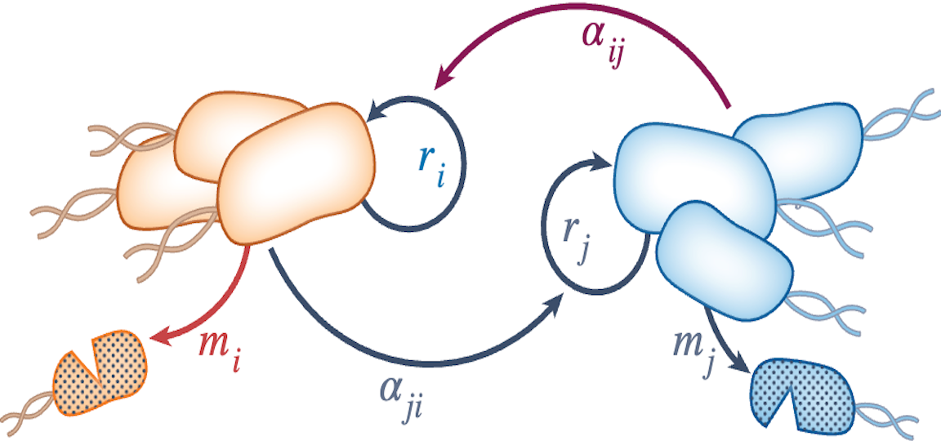
Different Models
Agent Based Model
Trait-based Model
Golding Model
Consumer-Resource Model
Lotka-Volterra Model

Slide 11
03
METHODOLOGY
DASHBOARD AND ODE MODEL

Slide 12
Simulation Flowchart

Slide 13
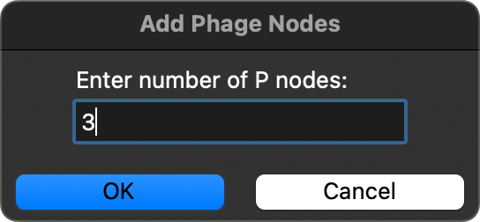
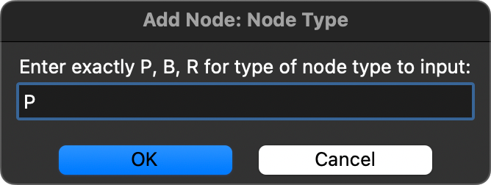

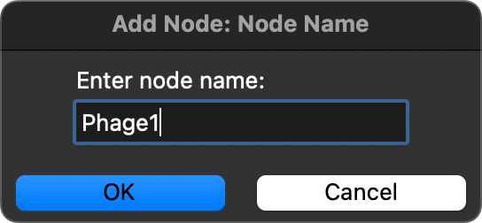
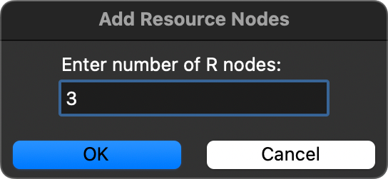
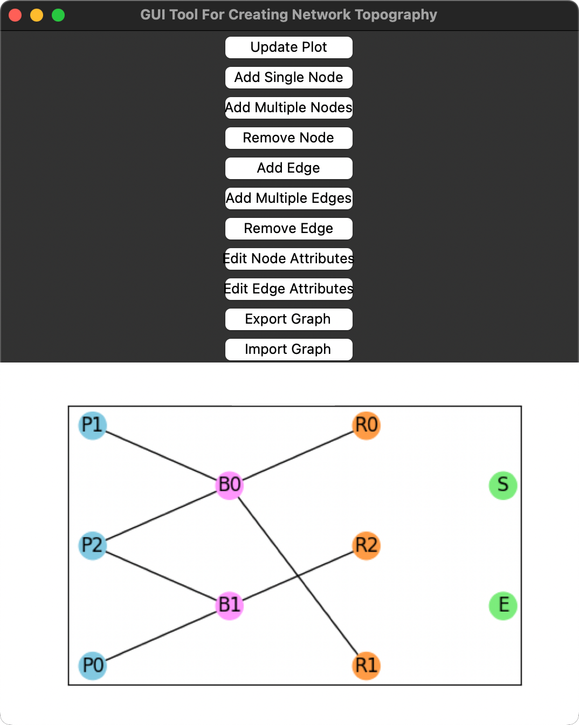
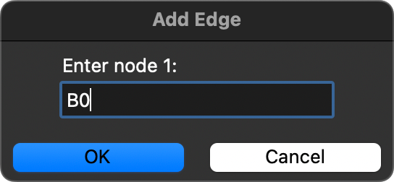
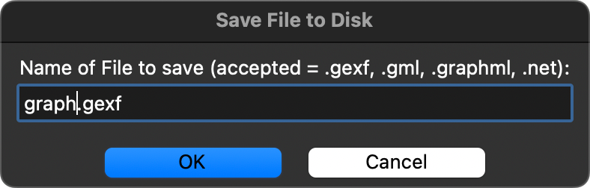
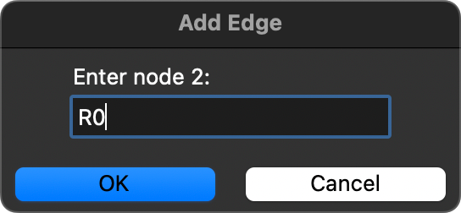
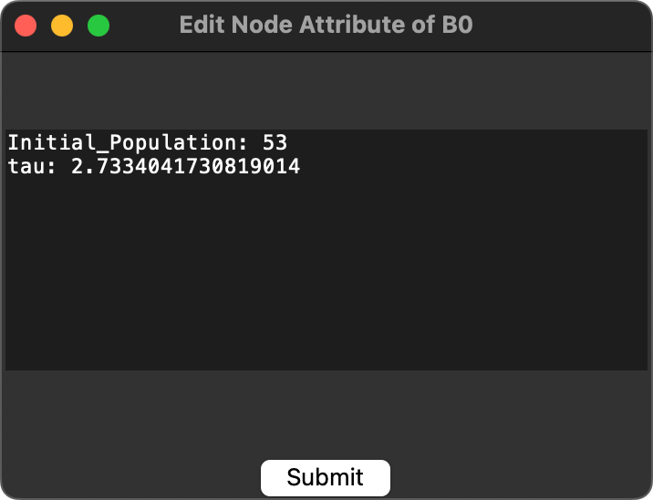
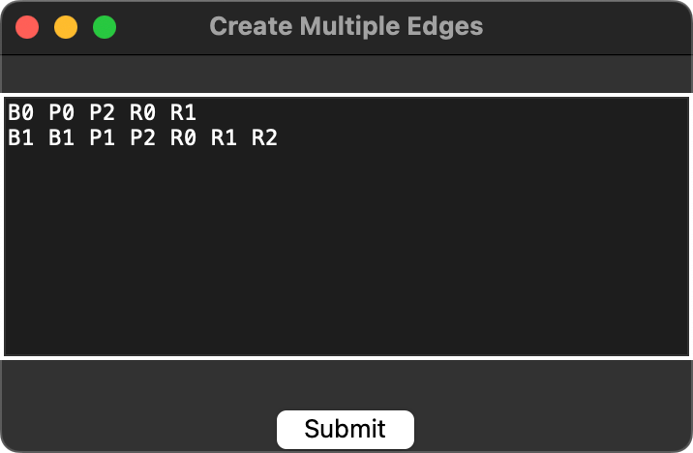
GUI Tool

Slide 14
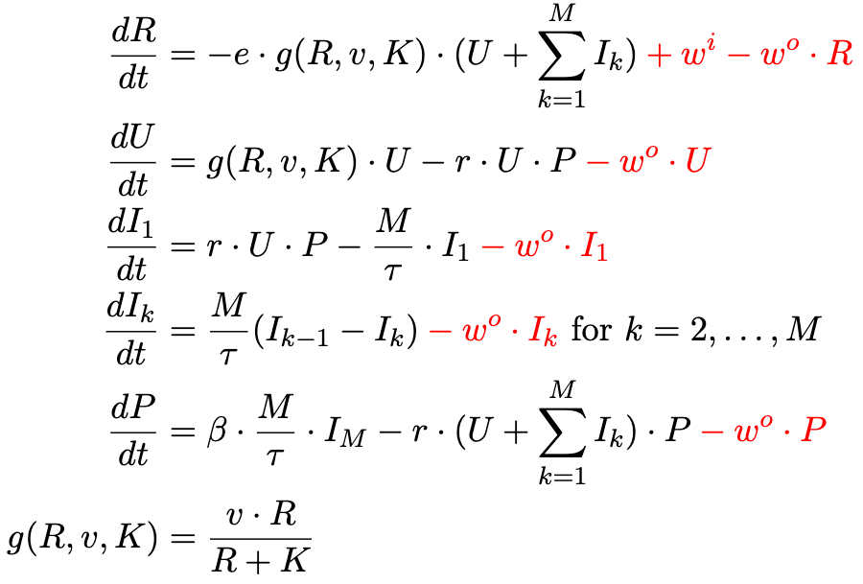
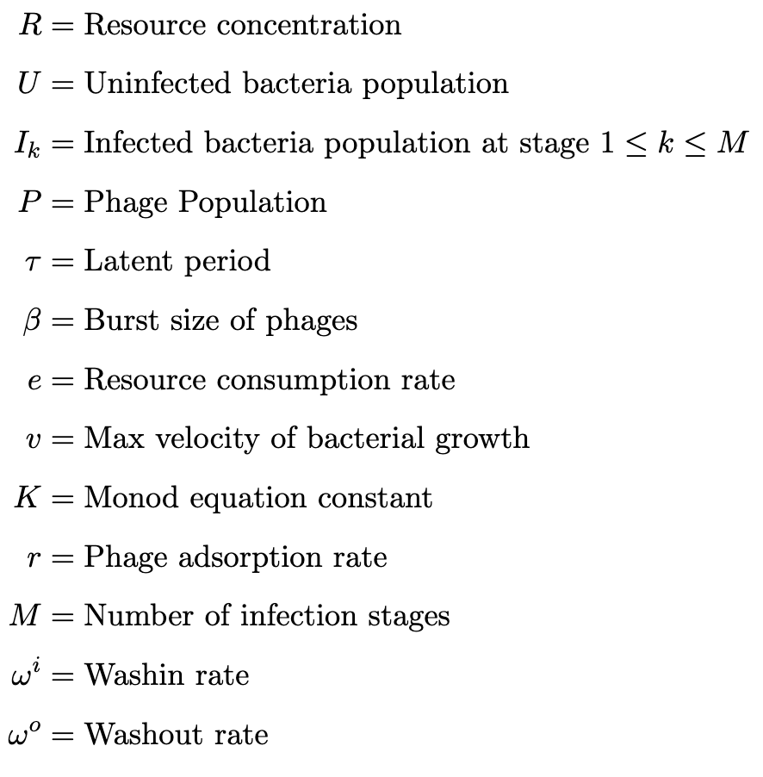
ODE Model – Golding Model

Slide 15
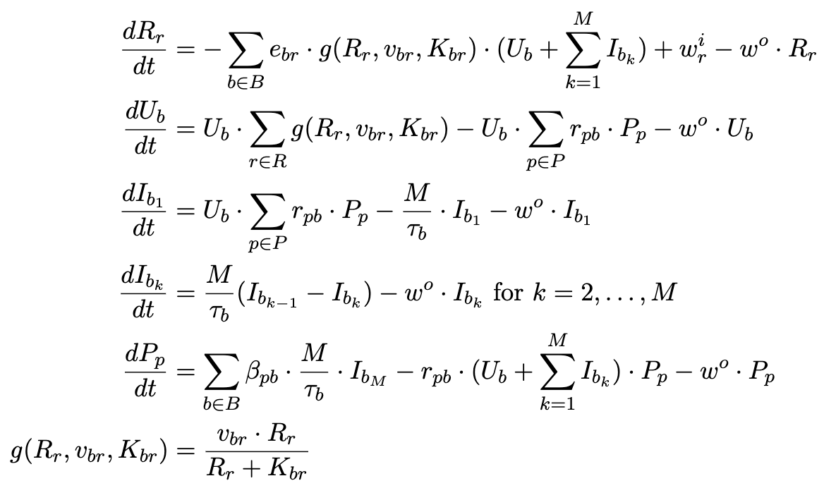
Adapted Golding Model for a pxbxr System

Slide 16

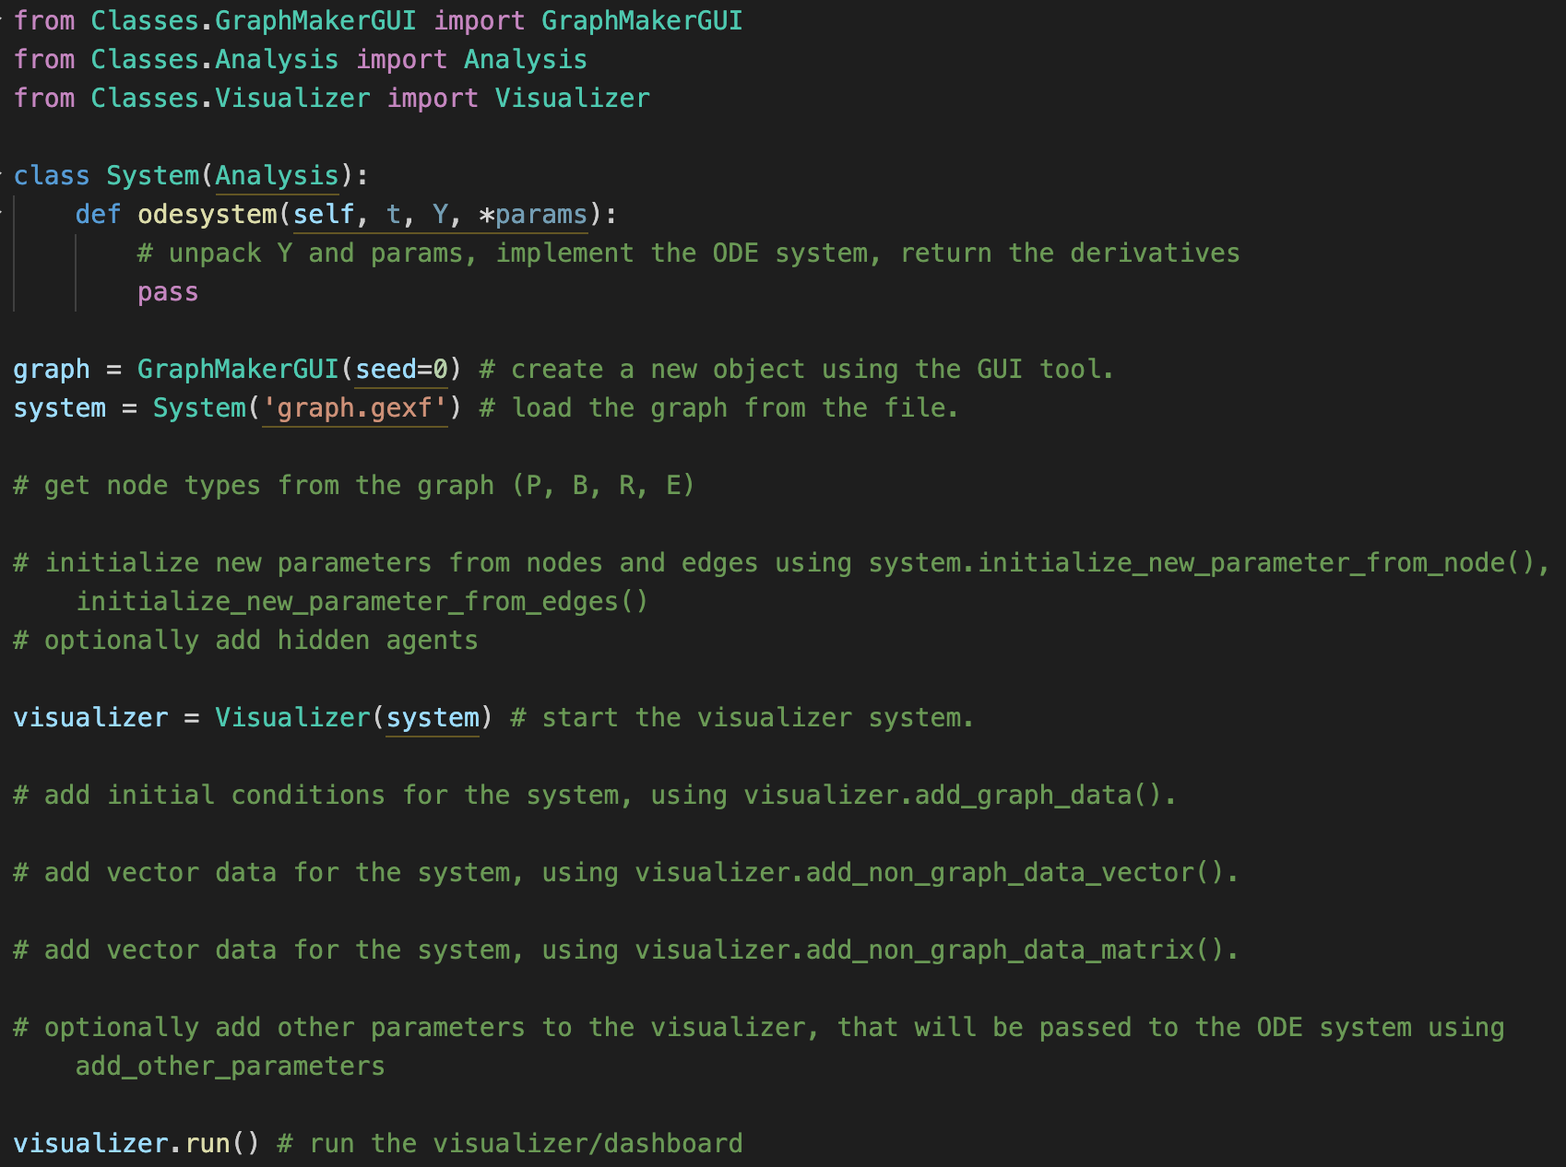
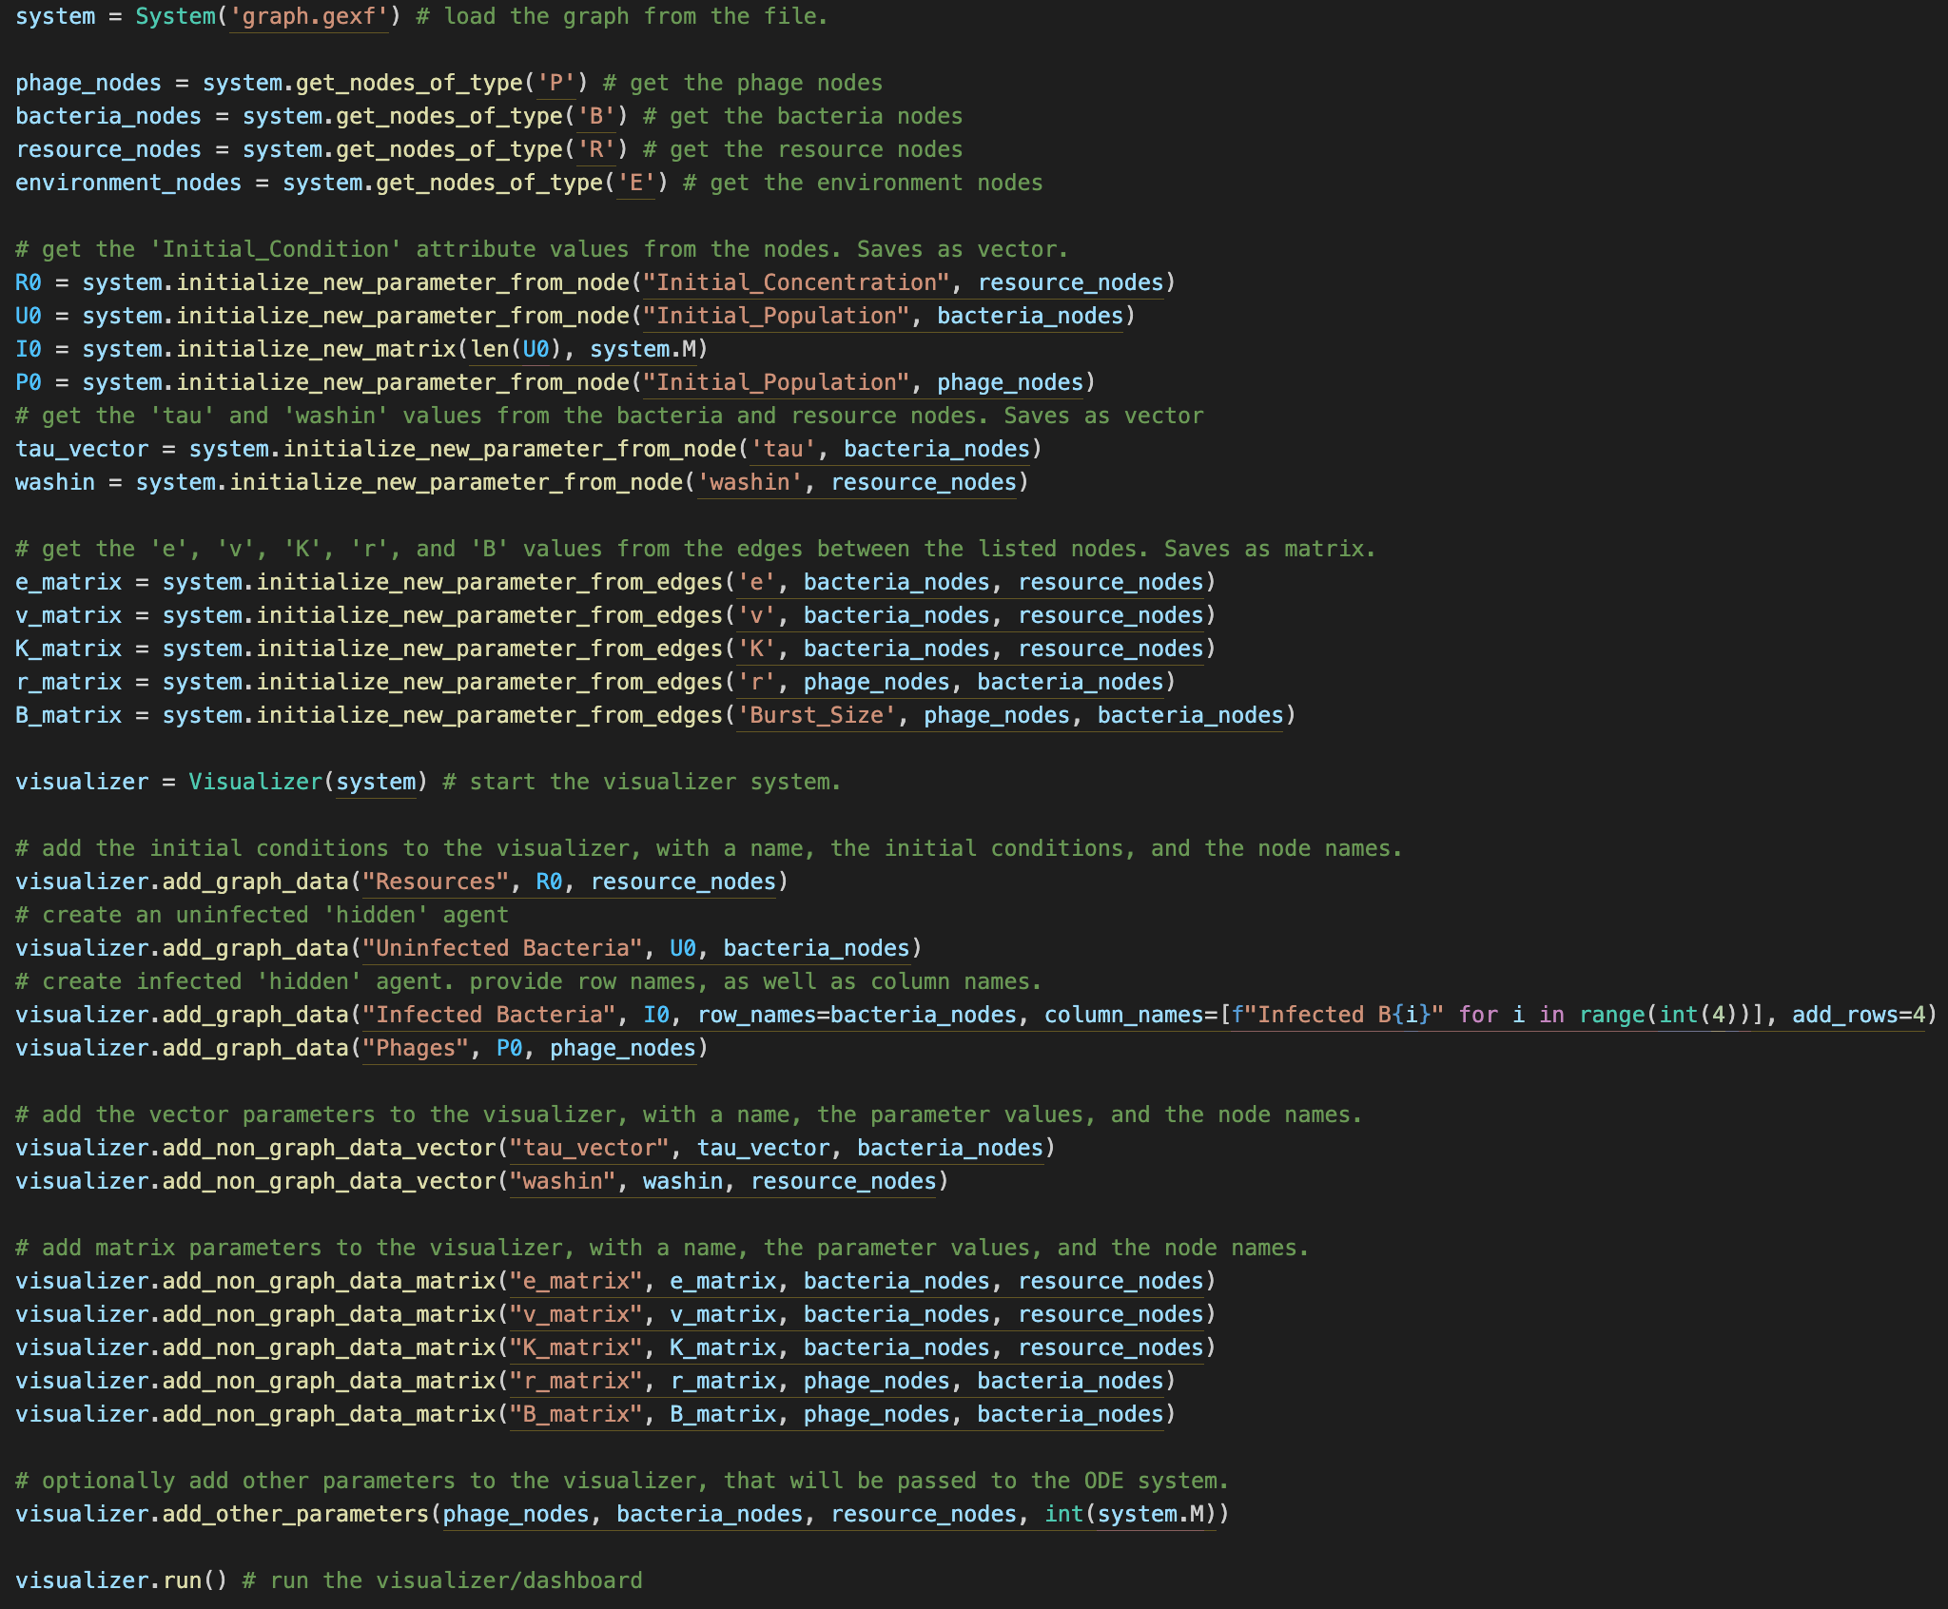
Running the Framework
Not fully automated, “manually” enter data
Low-code, boilerplate-like code
ODE code implementation

Slide 17
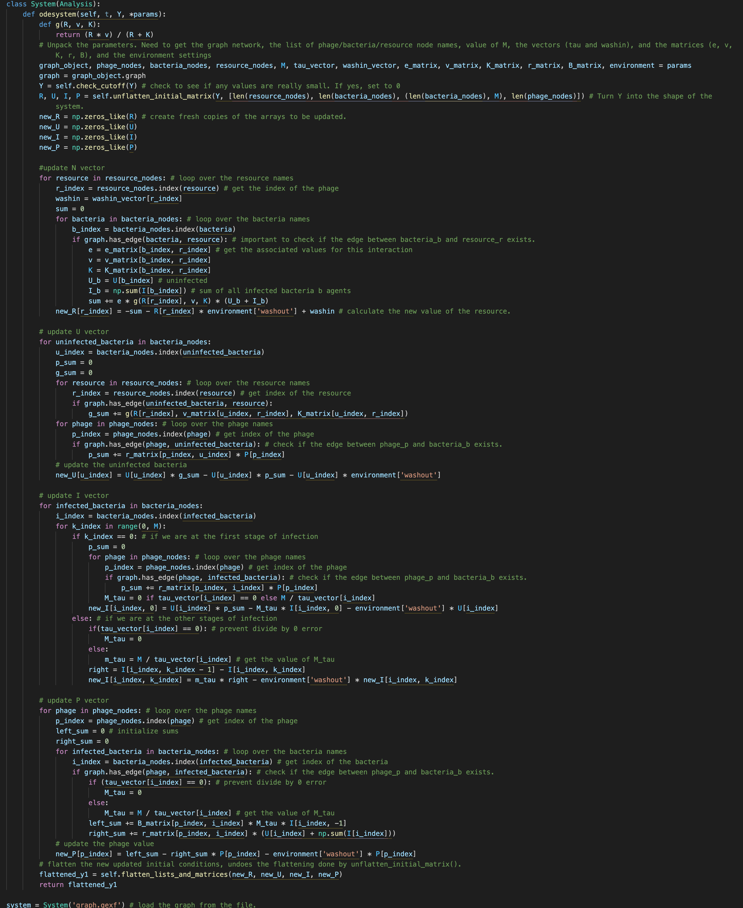
ODE Code

Slide 18
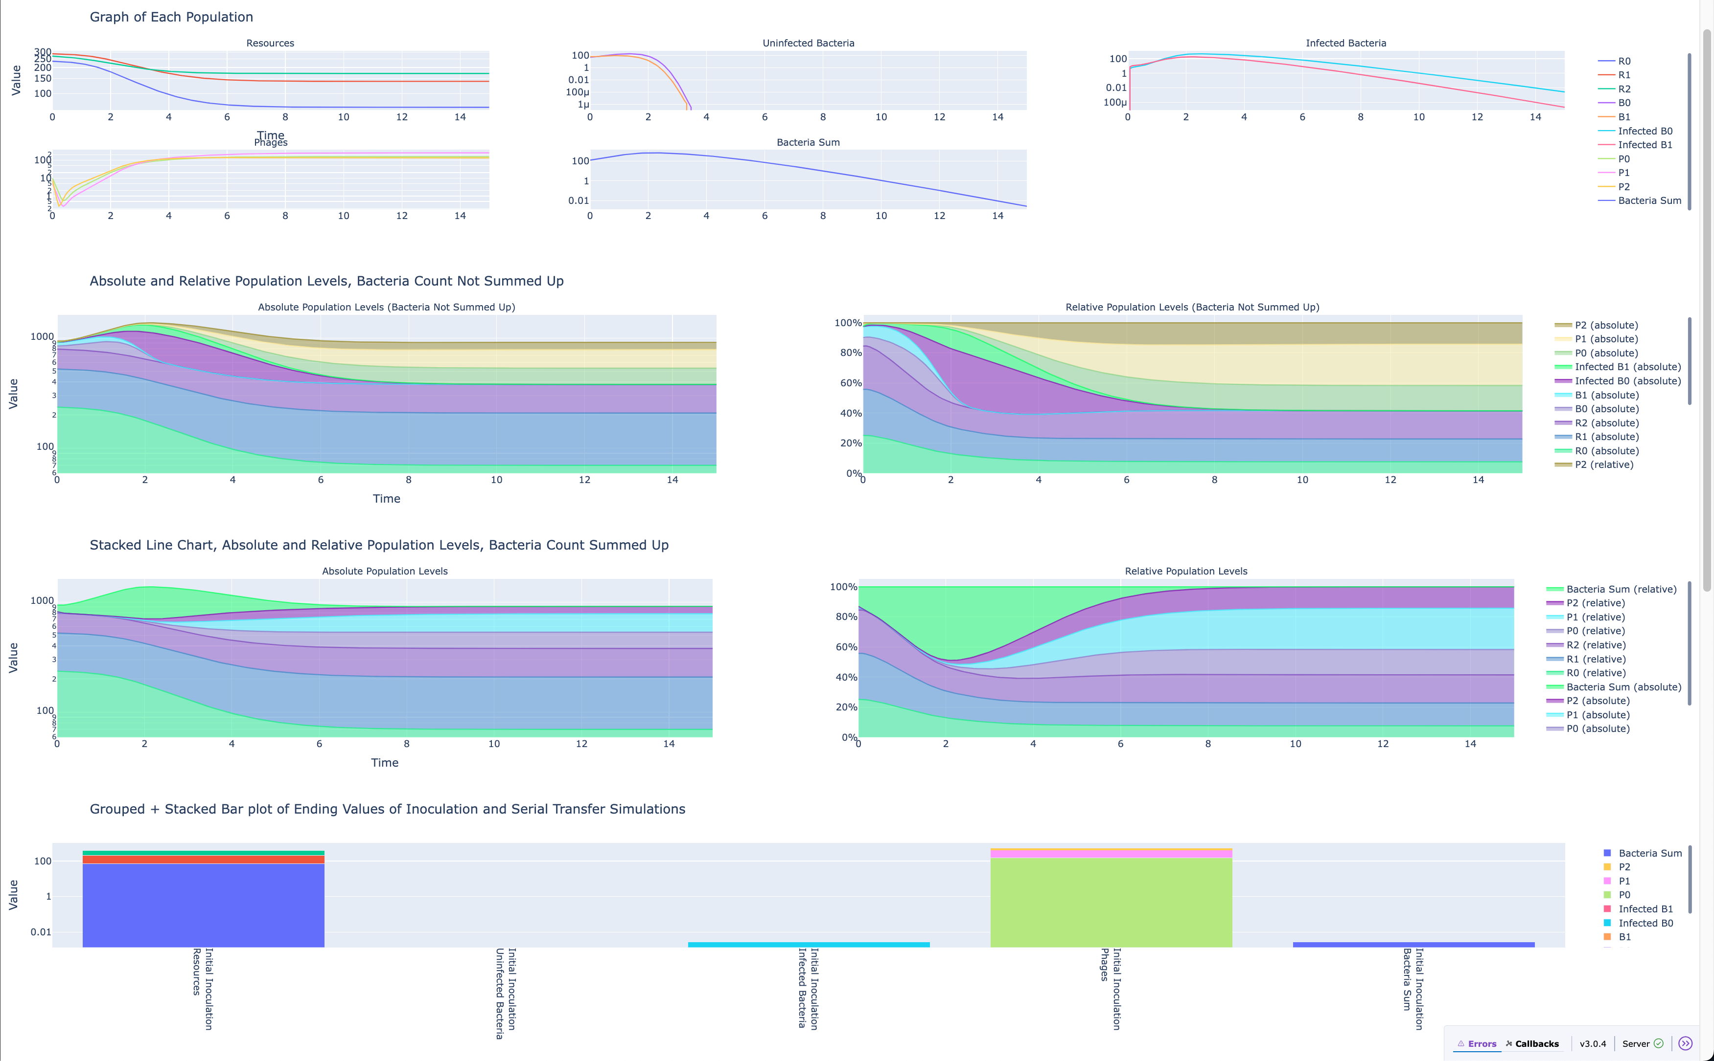
Dashboard – Plot Basic Graph

Slide 19
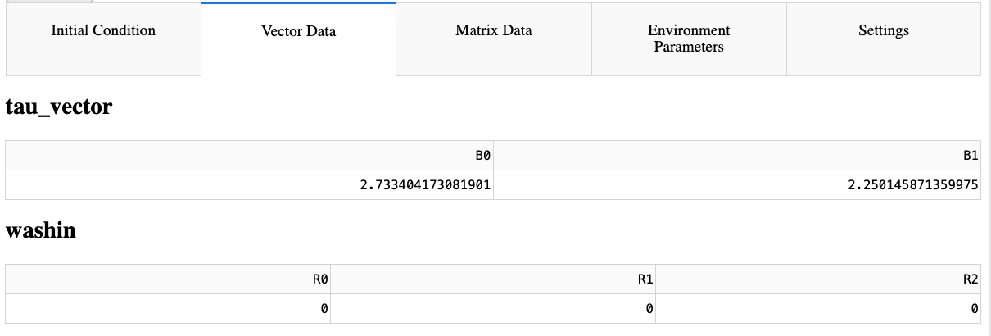
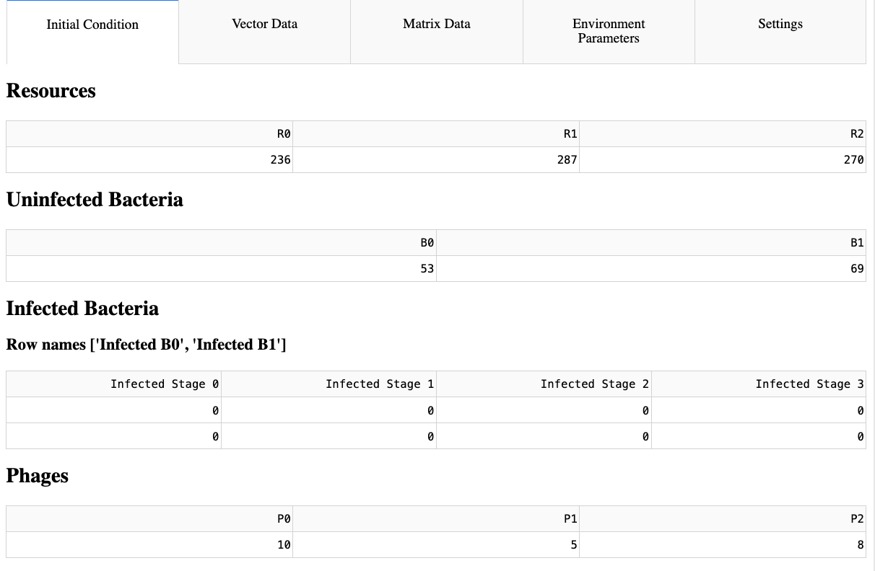
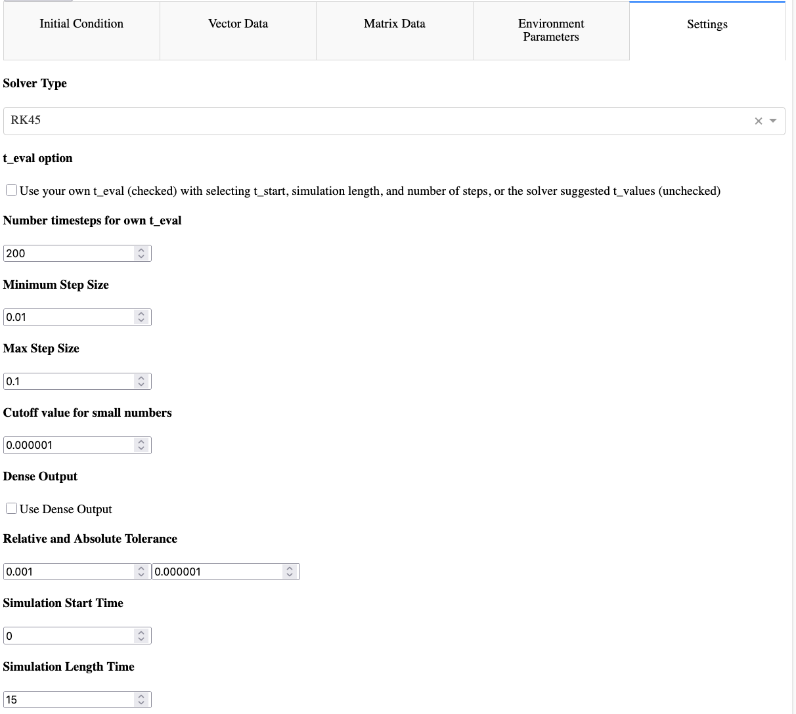
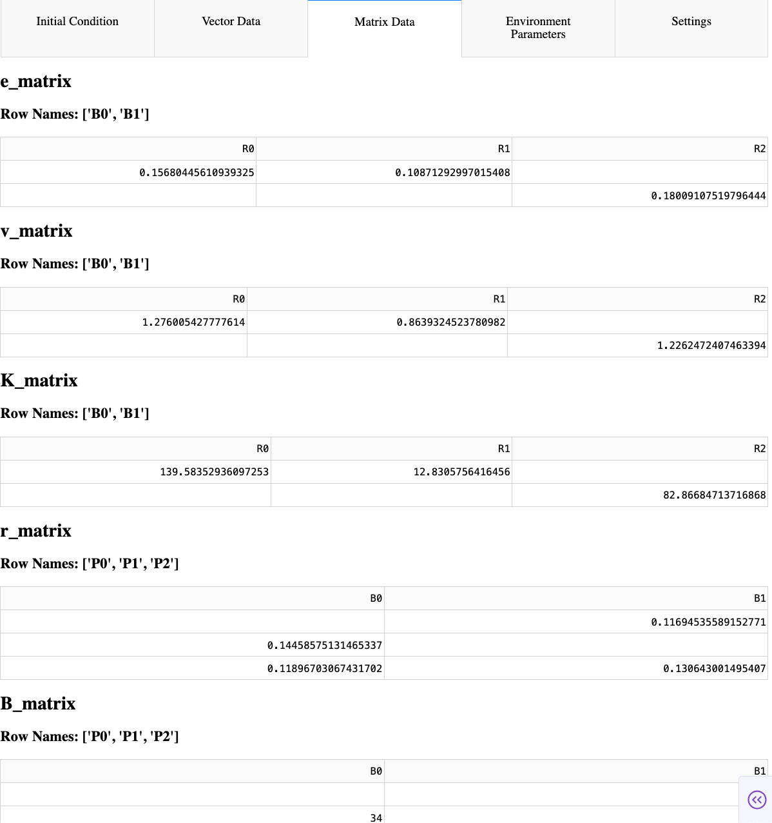
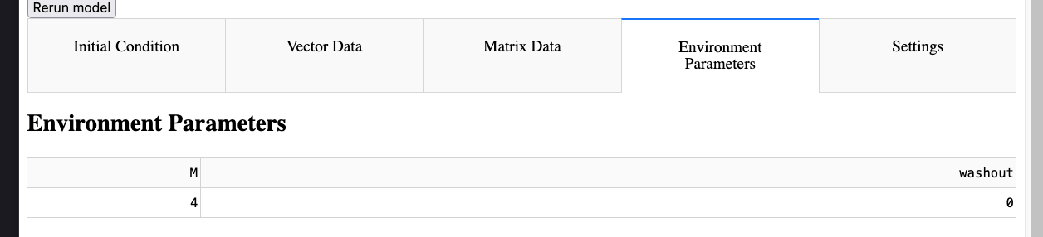
Dashboard – Edit Parameters

Slide 20
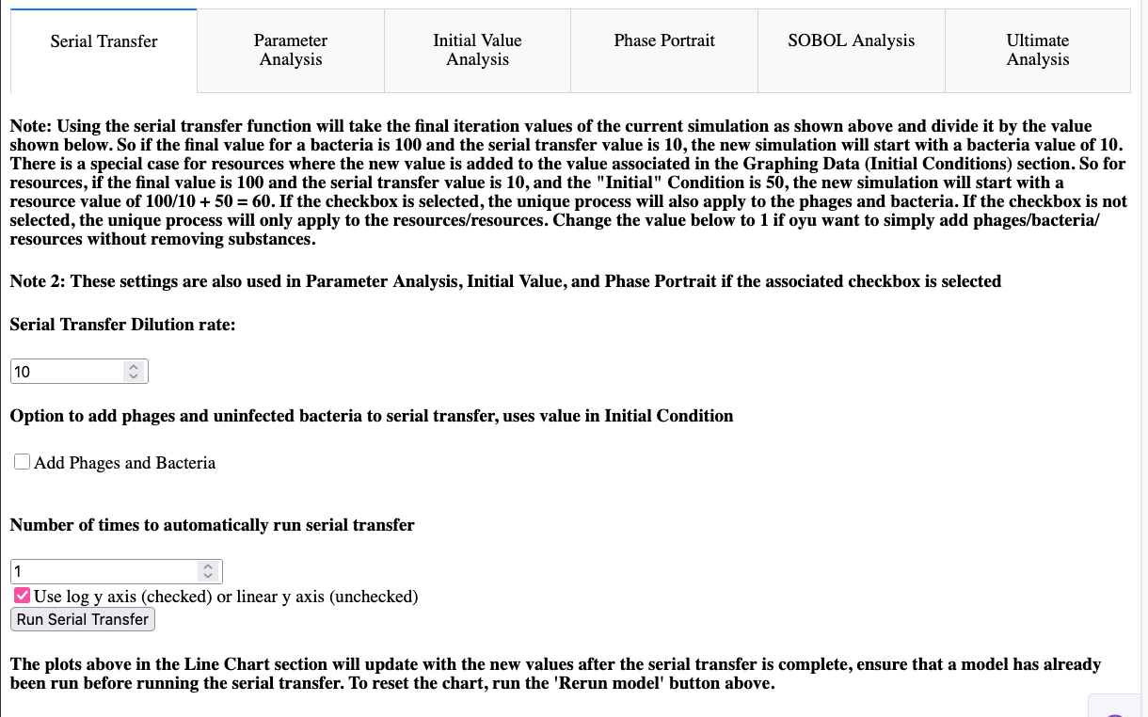
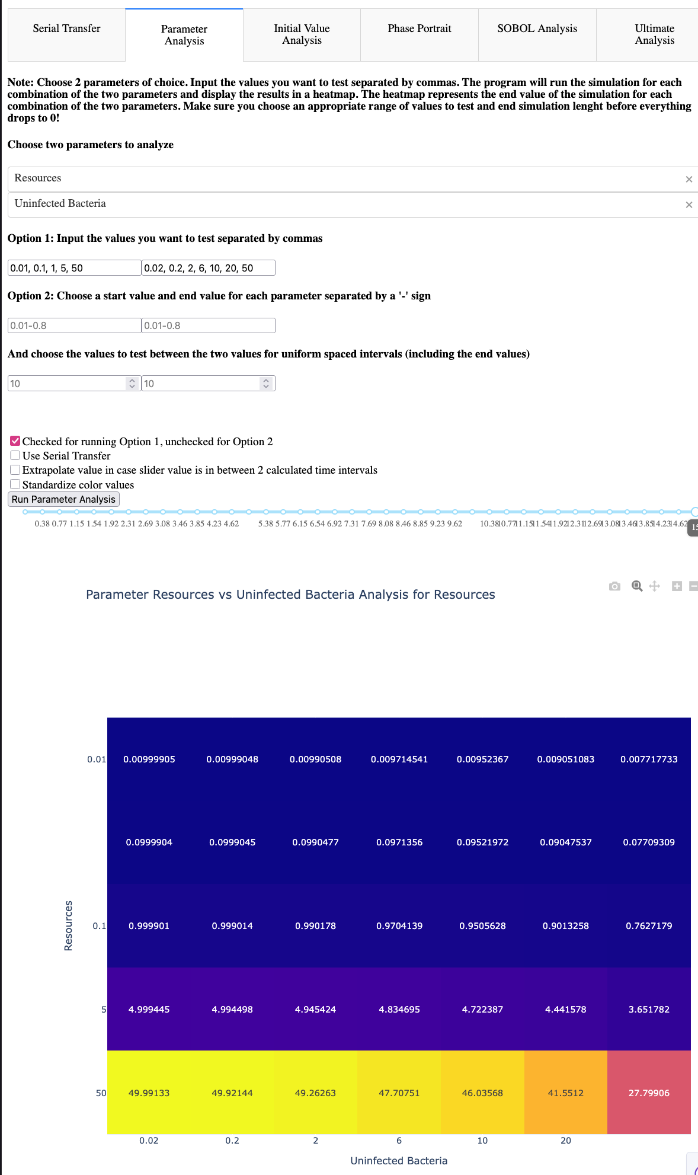
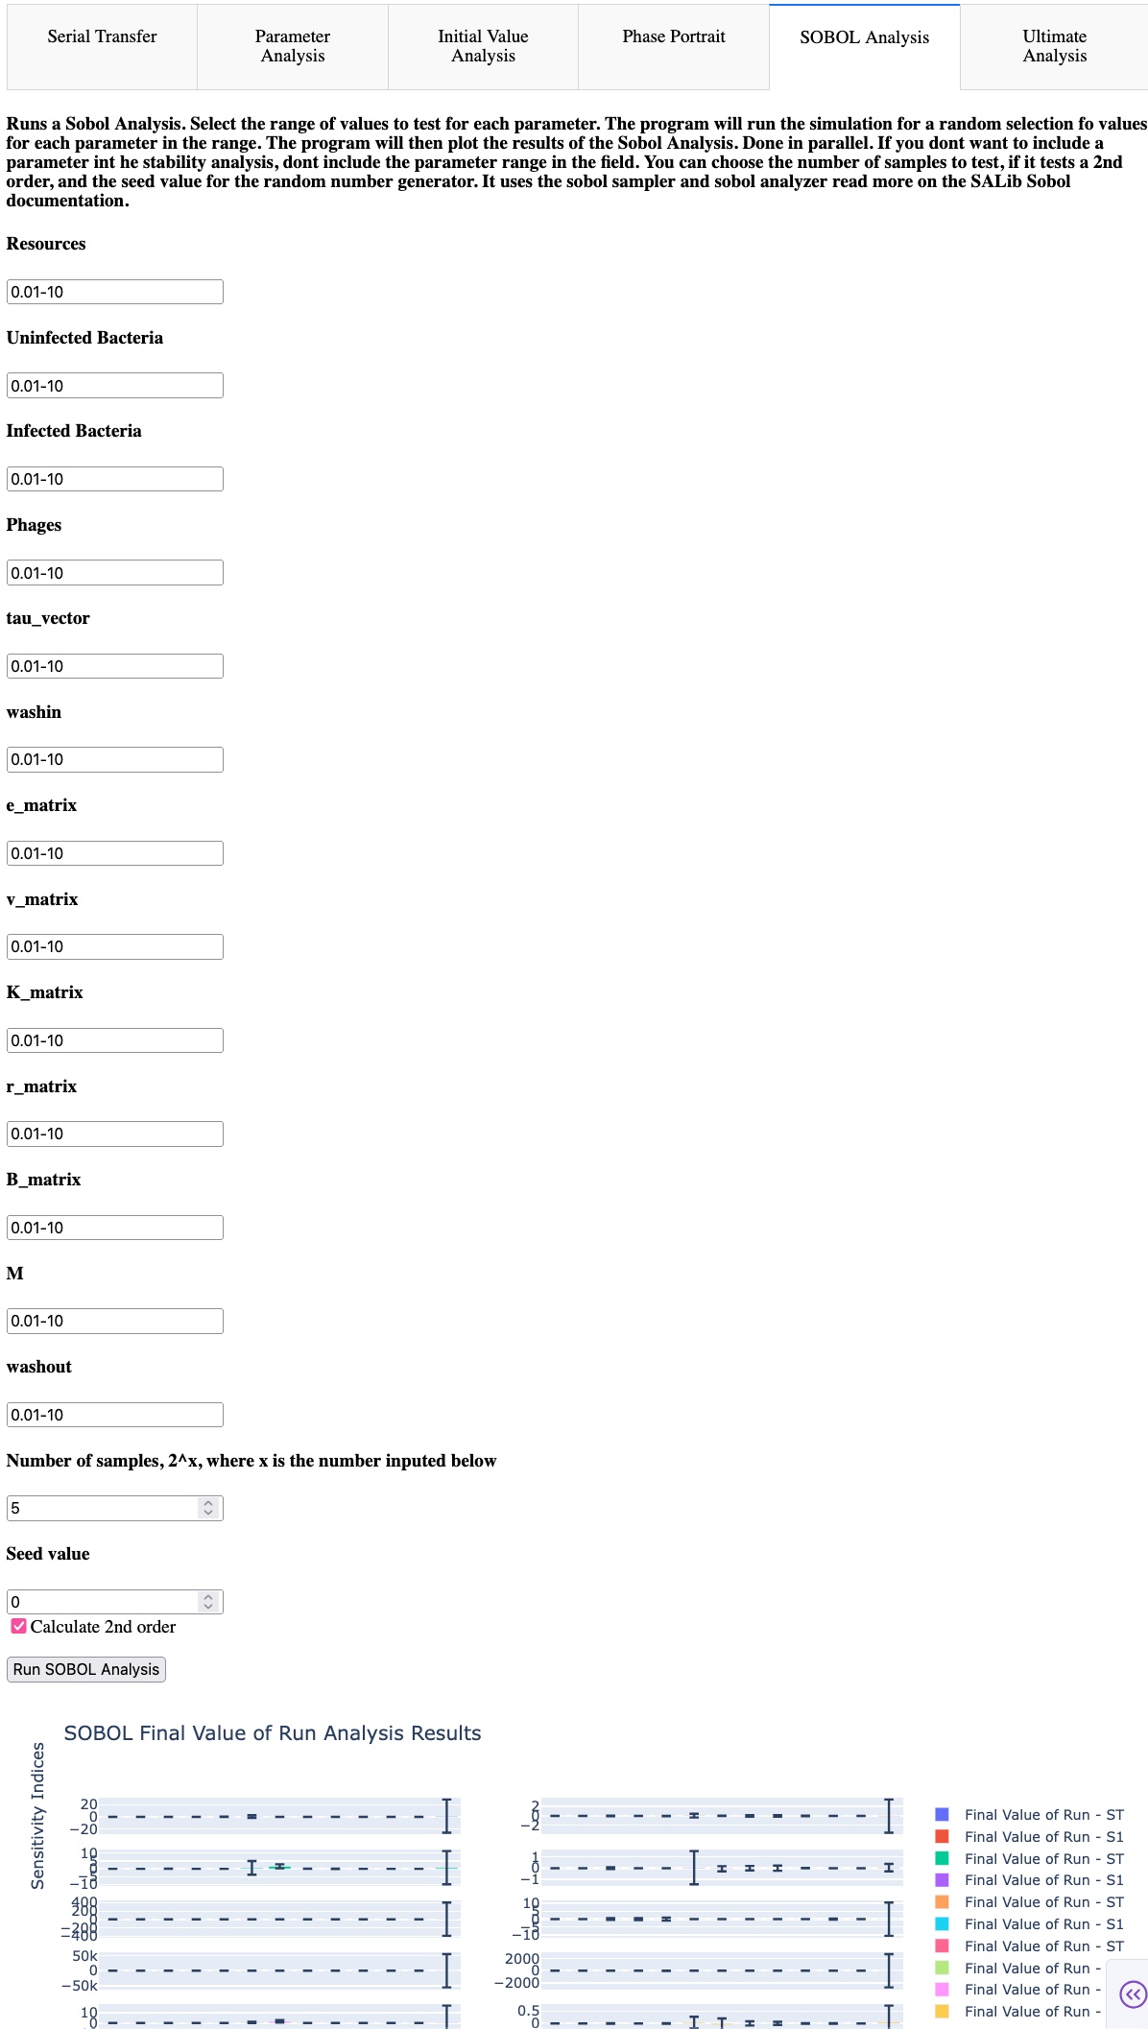
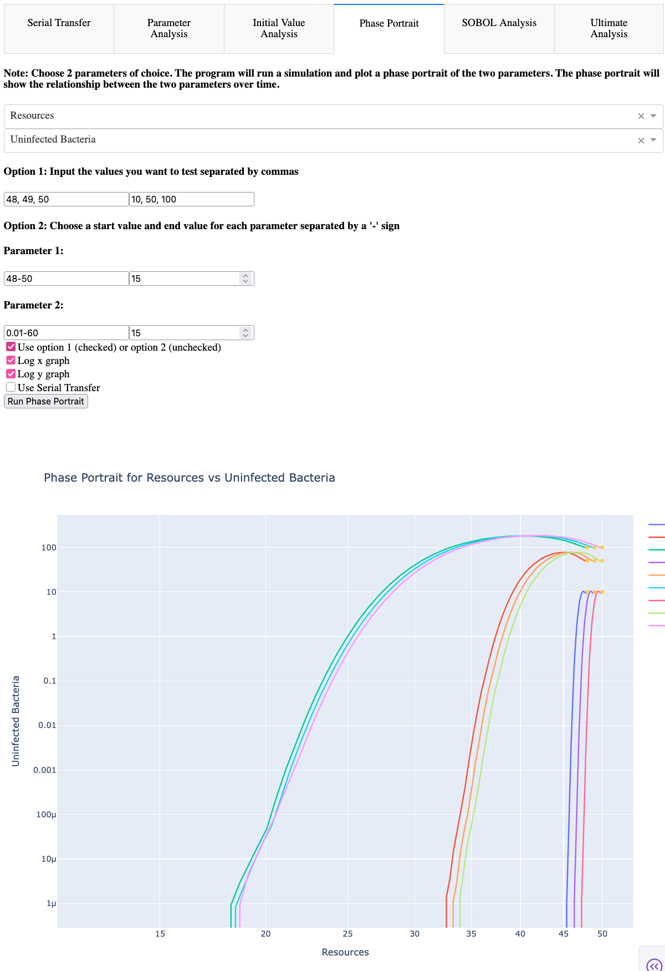
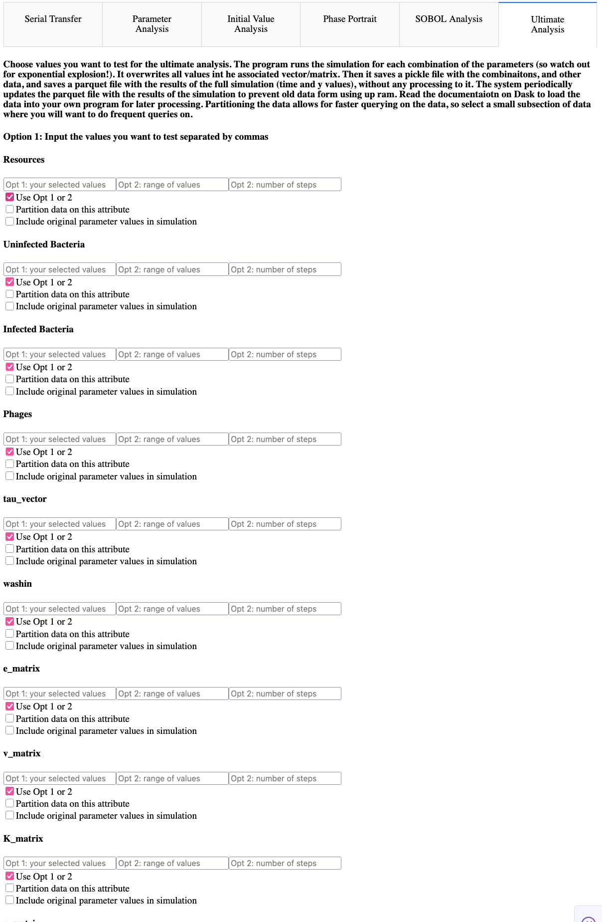
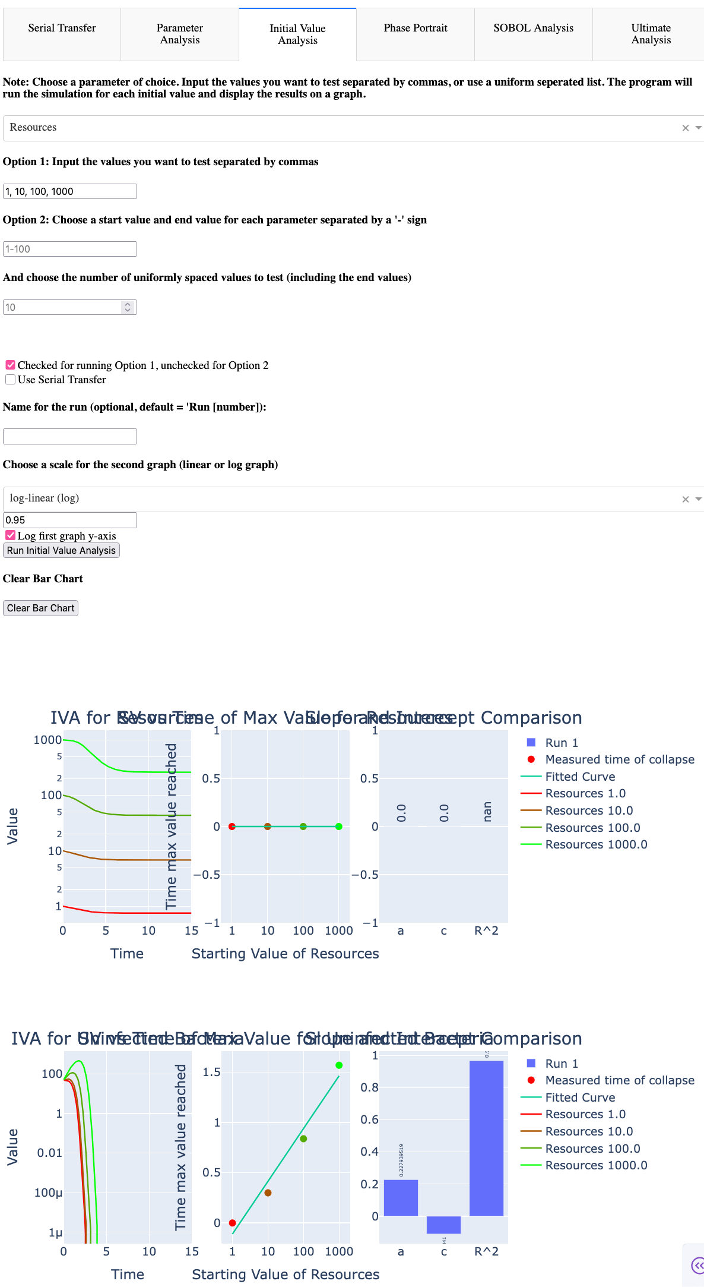
Dashboard - Advanced Analysis

Slide 21
Dashboard - Interactivity
Interaction is forefront
Selectable dropdowns to alter input type
Options to change axis-scale
Optionally run Serial Transfer iterations
Change parameter values and solver settings
Self-decided parameter values or range of parameter values
Every graph element is hoverable – displays parameter condition, compare values,

Slide 22
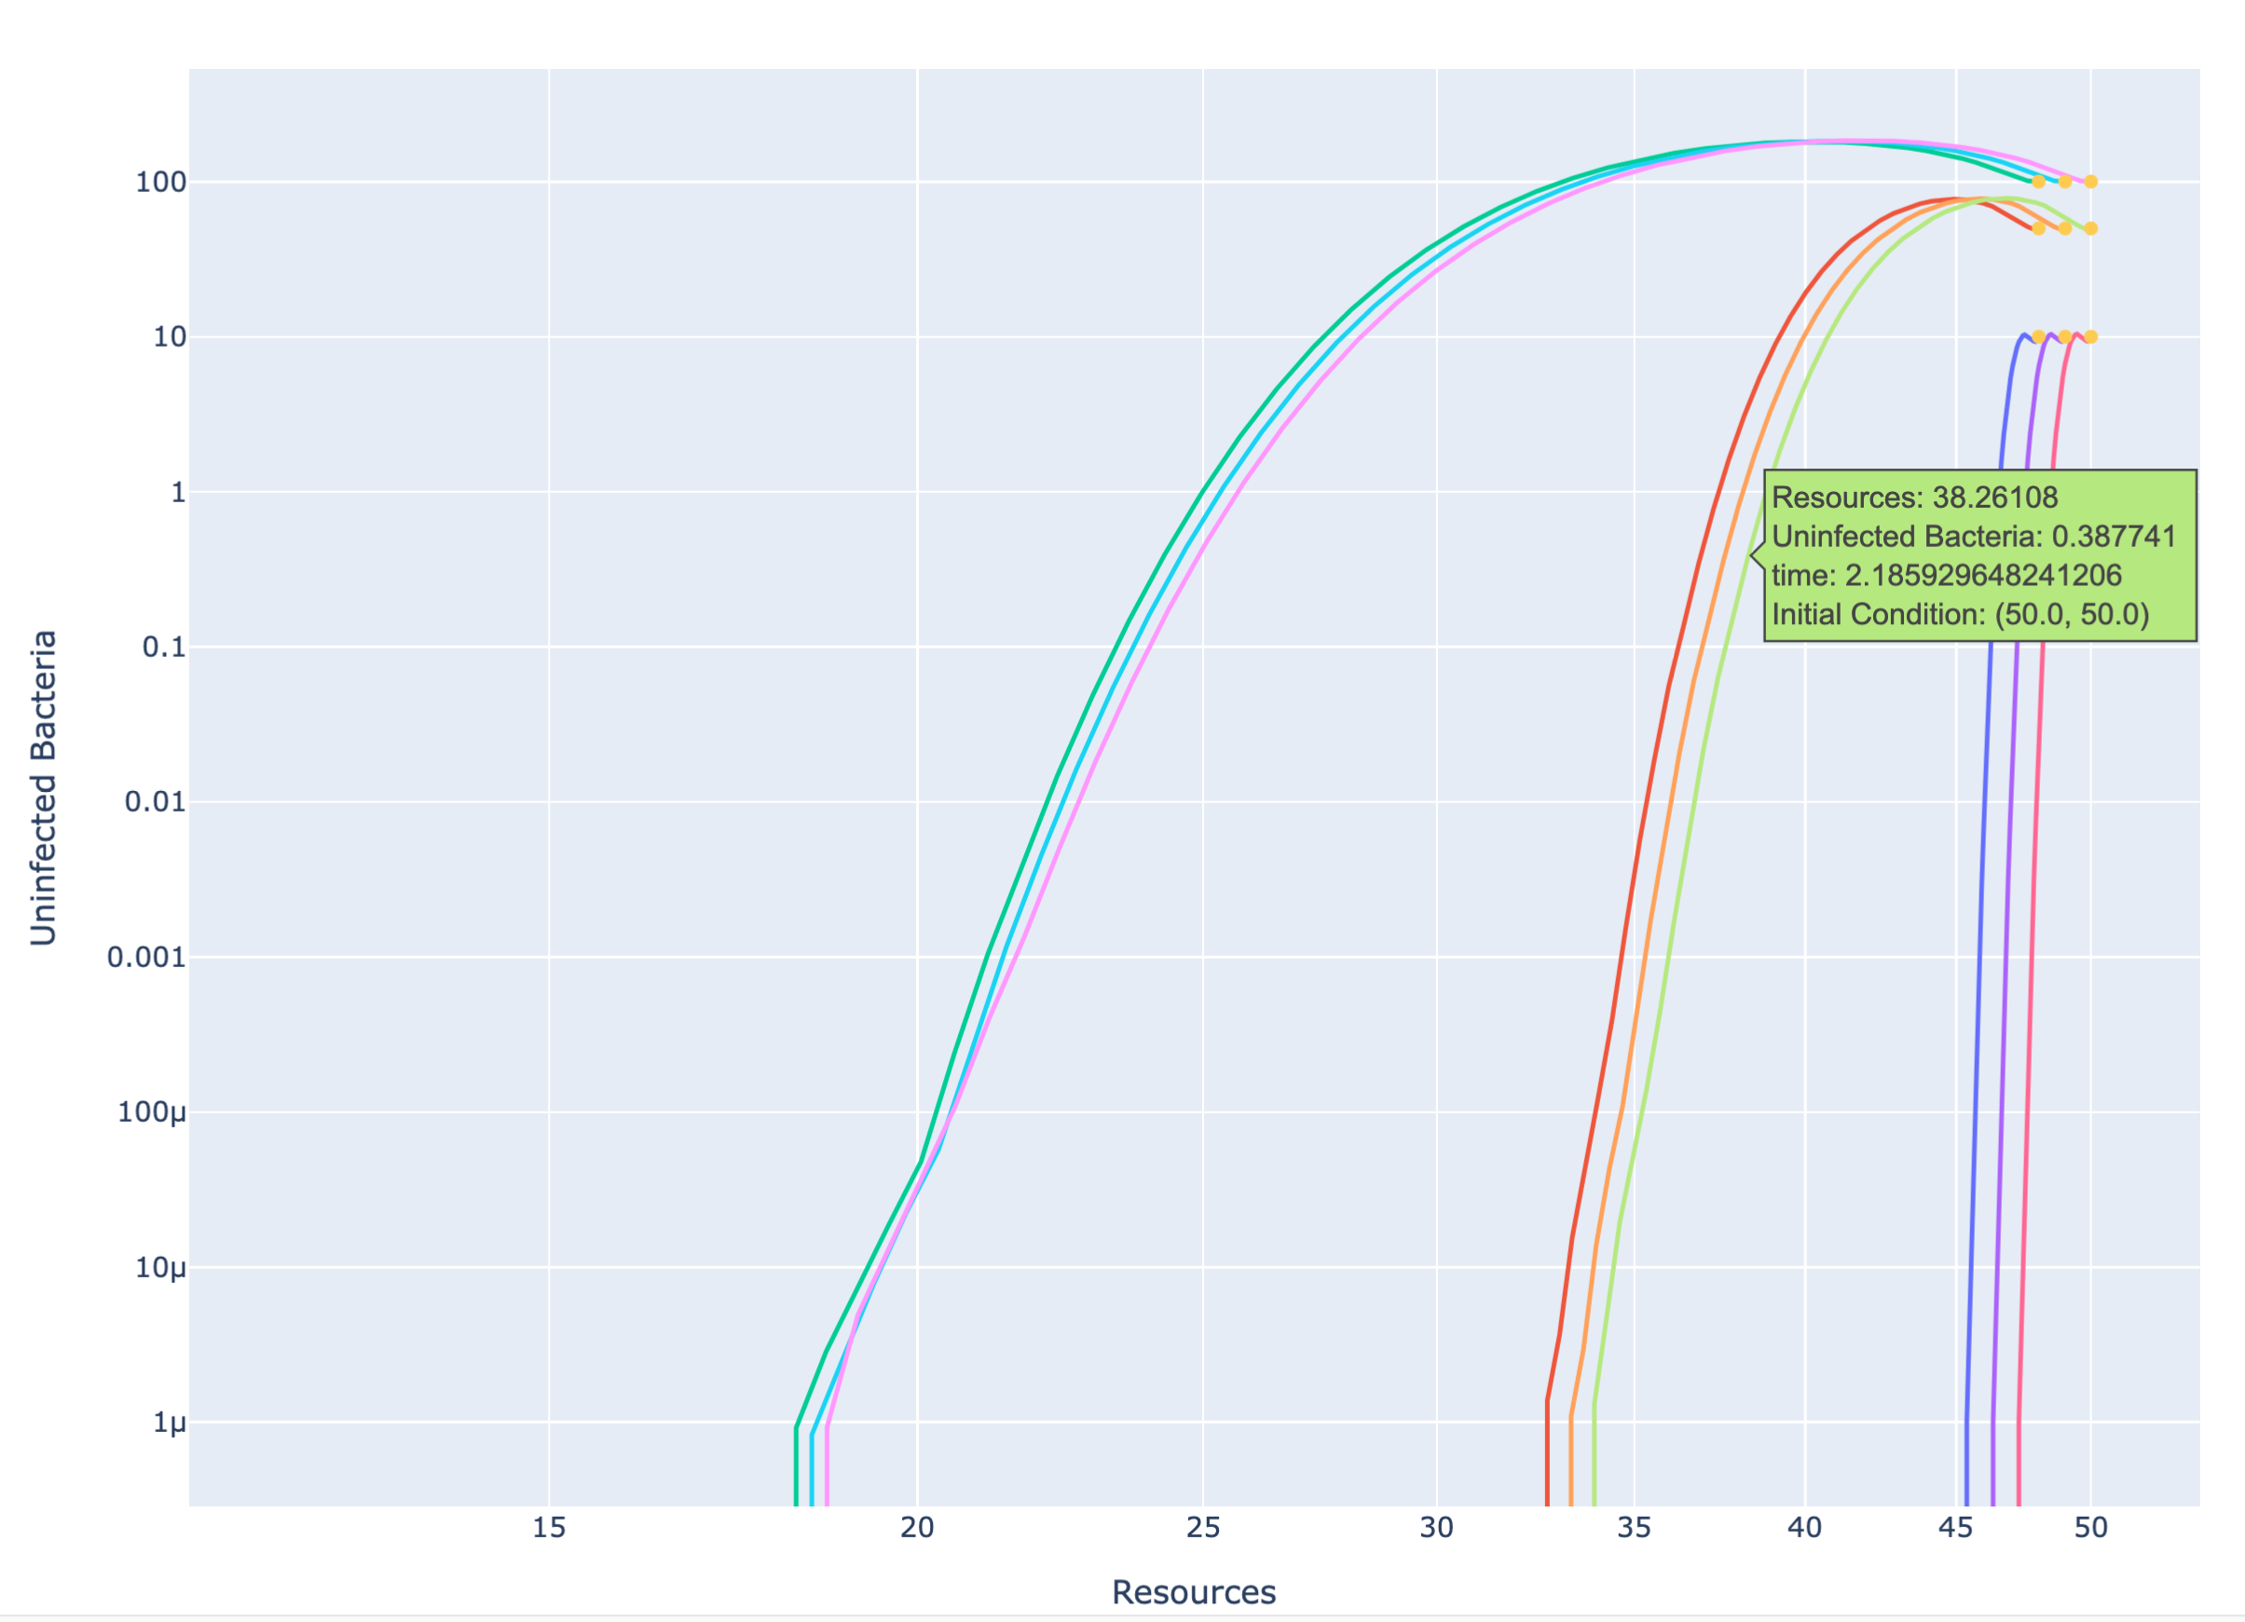
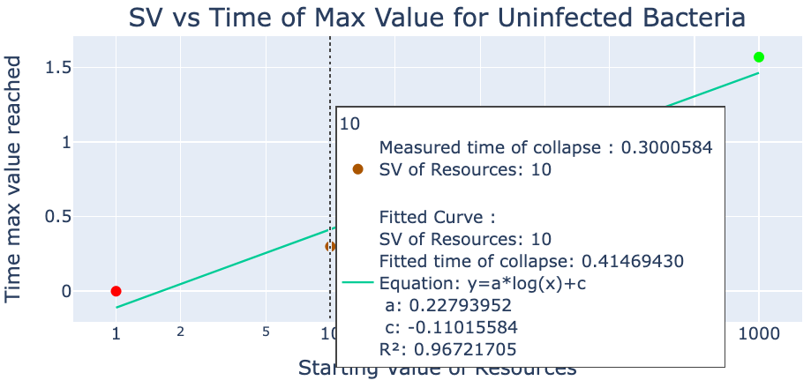
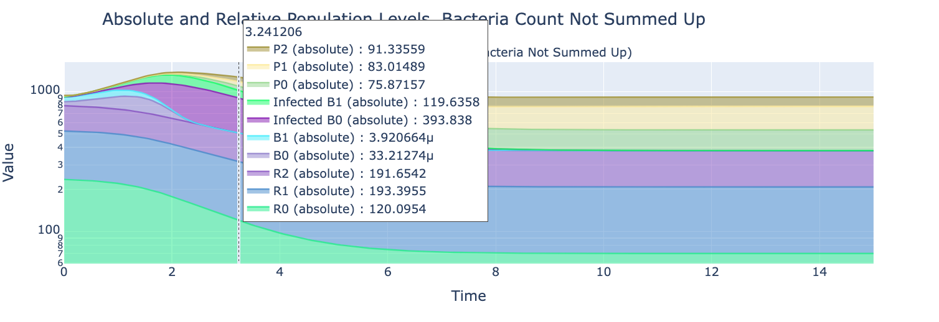
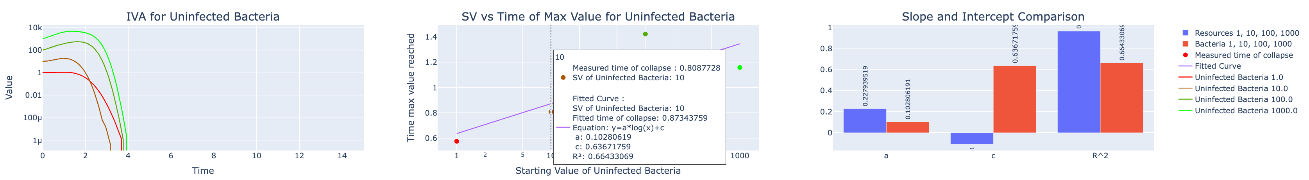
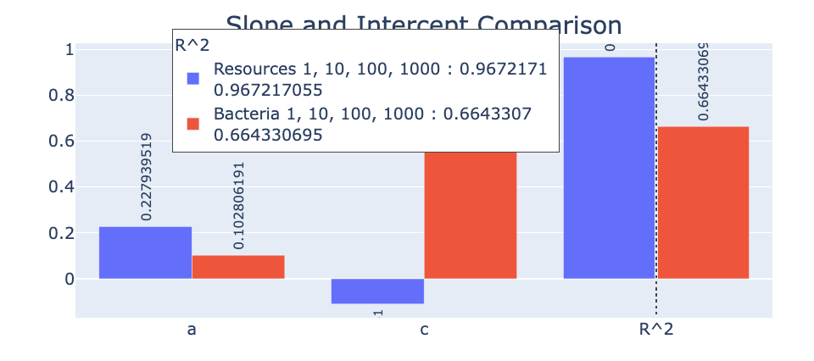
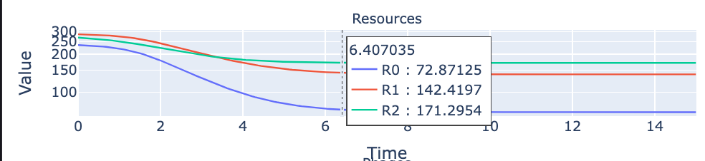
Dashboard - Interactivity

Slide 23
04
RESULTS
COLORFUL PLOTS AND LINES!

Slide 24
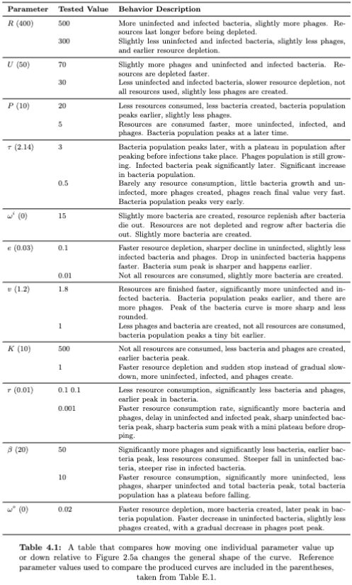
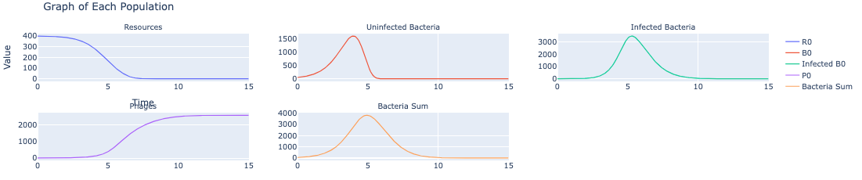
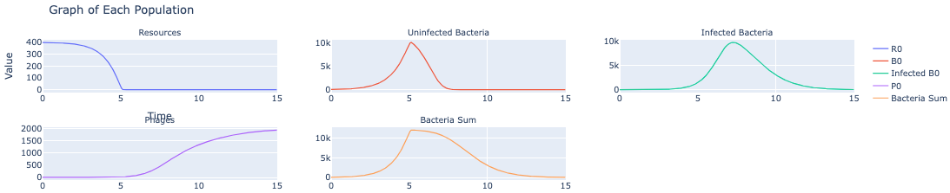

Graph Behavior - Biologist POV
Tau = 2.14 (reference value)
Tau = 3 (slower latent time)
Tau = 0.5 (faster latent time)

Slide 25



Graph Behavior – Computational Scientist POV

Slide 26



Graph Behavior – Computational Scientist POV

Slide 27
Biologist POV + Computational Scientist POV =
Greater understanding than just individually!

Slide 28
05
ANALYSIS AND CONCLUSIONS
BIGGEST TAKEAWAYS

Slide 29



Next Steps
CODE
LAB
MODEL
Documentation + Code Cleanup
Ready to Use Code Samples
New tools and features
Compare Lab Data to Model Data
Create Custom ODE Model for the Lab
Replicate Environmental and Lab Data
Finetune model parameters and equation
Compare different model outputs

Slide 30
BIBLIOGRAPHIC REFERENCES
AUTHOR (YEAR). Title of the publication. Publisher
AUTHOR (YEAR). Title of the publication. Publisher
AUTHOR (YEAR). Title of the publication. Publisher
AUTHOR (YEAR). Title of the publication. Publisher
AUTHOR (YEAR). Title of the publication. Publisher
AUTHOR (YEAR). Title of the publication. Publisher
AUTHOR (YEAR). Title of the publication. Publisher
AUTHOR (YEAR). Title of the publication. Publisher
AUTHOR (YEAR). Title of the publication. Publisher

Slide 31
THANK YOU

